Slide 1

Rockbuster Stealth, LLC
Staying competitive in a world of streamlining
Data Analyis by Margo Shogren
This Photo by Unknown Author is licensed under CC BY-NC-ND

Slide 2
This is a world of many film streaming options. so how can Rockbusters video rental stay competitive?
This analysis will examine the current data of Rockbuster video including the sales, products, customers and pricing
Where are Rockbuster customers are now?
What are the Rockbuster customers renting?
How does Rockbuster rental pricing affect the revenue?

Slide 3
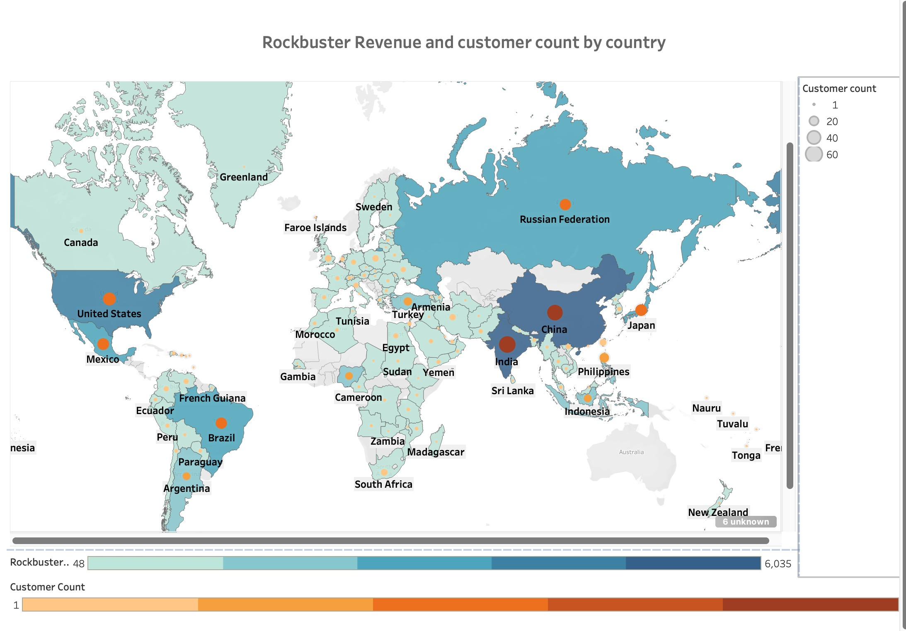
This map shows Rockbuster video with highest revenue by country in darker blue areas and darker orange spots with higher number of customers.

Slide 4
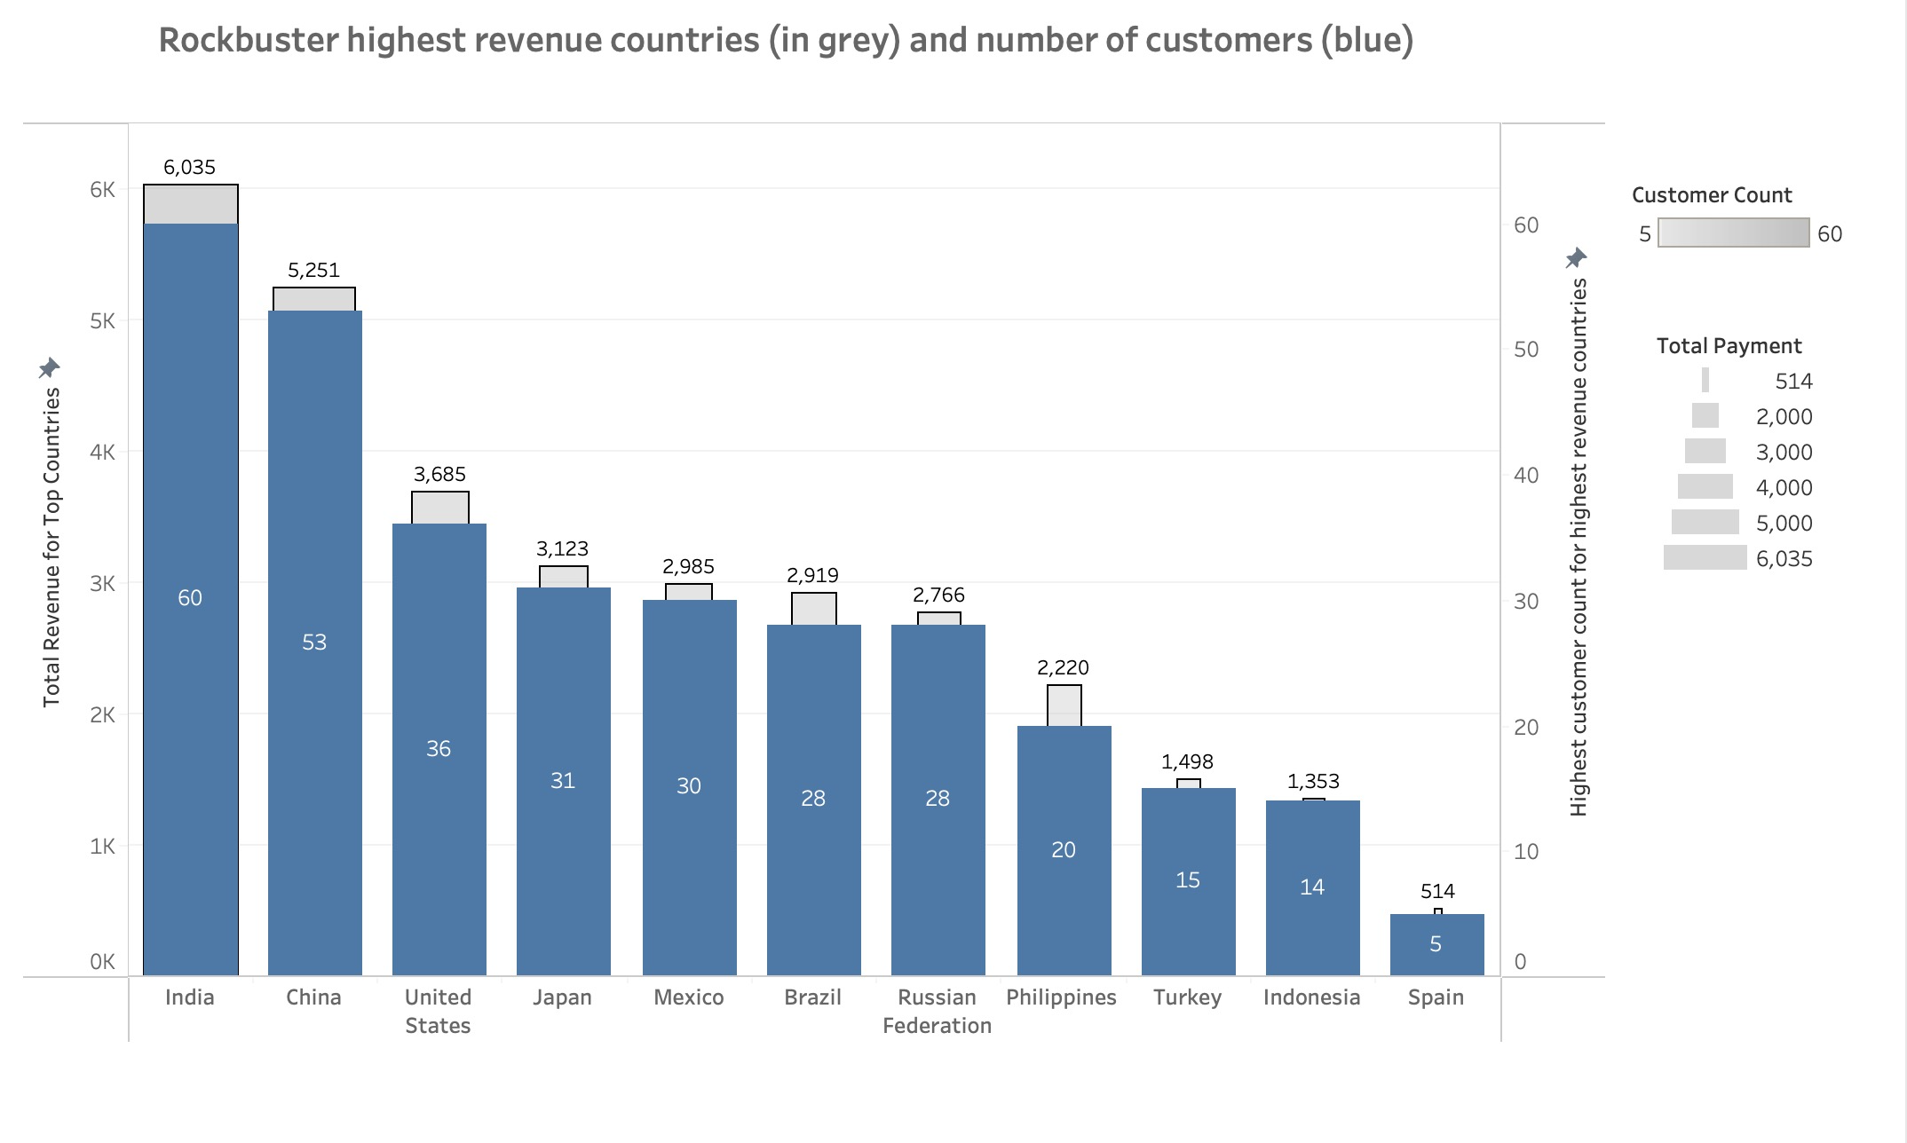
The two countries with the highest revenue for Rockbuster are: India and China

Slide 5
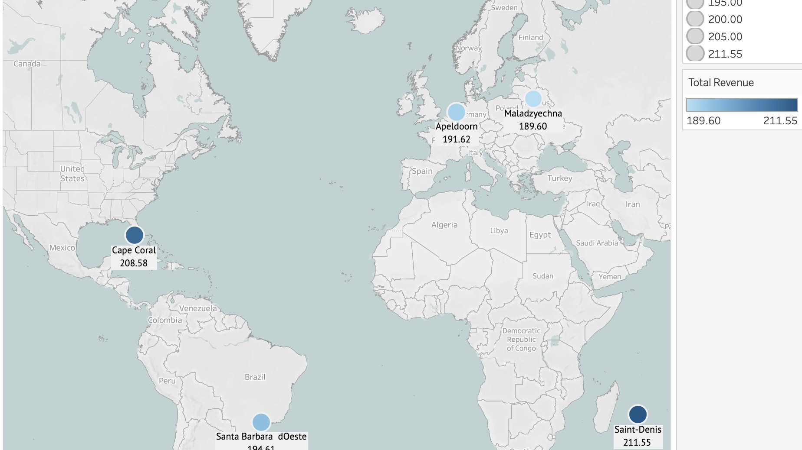
These are the cities where the top 5 most loyal customers in terms of revenue reside.
Most of these are in fairly remote areas, perhaps areas where streaming products are more limited.

Slide 6
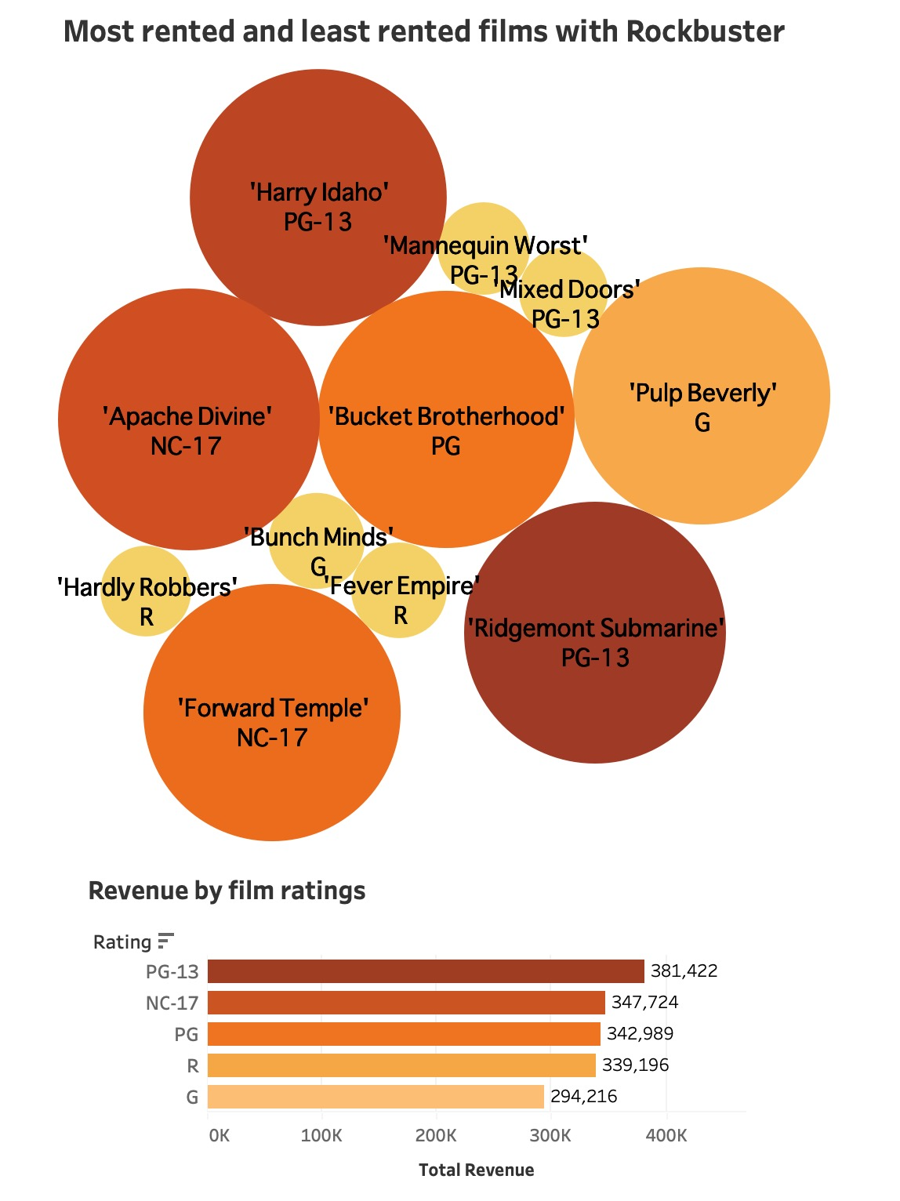
The large circles are the most rented film titles and small circles are the least rented. Rockbuster can be more competitive if the films available through Rockbuster films are films that may be difficult to find on streaming products.
What are Rockbuster customers renting?

Slide 7
Types of films rented by rockbuster
Categories rented: All Drama
Languages rented: All English
Rockbuster is only renting categories listed as Drama, English language and may consider more varieties to be more competitive.

Slide 8
Rockbuster videos rented for rental rates of $2.99 have the longest rental duration and the lowest total revenue.

Slide 9

Conclusion and recommendations
Locations
Rockbuster currently receives the highest revenue from the countries of India and China. Rockbuster should continue to concentrate marketing in those countries.
Rockbuster can also target market resources in remote areas where customers have less streaming opportunities
Products
Rockbuster should offer movie titles that streaming services do not offer. Review the popular titles that are rented and offer a wide variety of categories and languages.
Pricing
Rockbuster could experiment with changing pricing options or extra day rental charges and assess the impact on revenue.

Slide 10
Appendix

Slide 11
Appendix

Slide 12

Questions?
-Margo Shogren
Data Analyst
Margo.Shogren@gmail.com

